Slide 1



Bank Loan Report Dashboard
View in Power BI

Slide 2
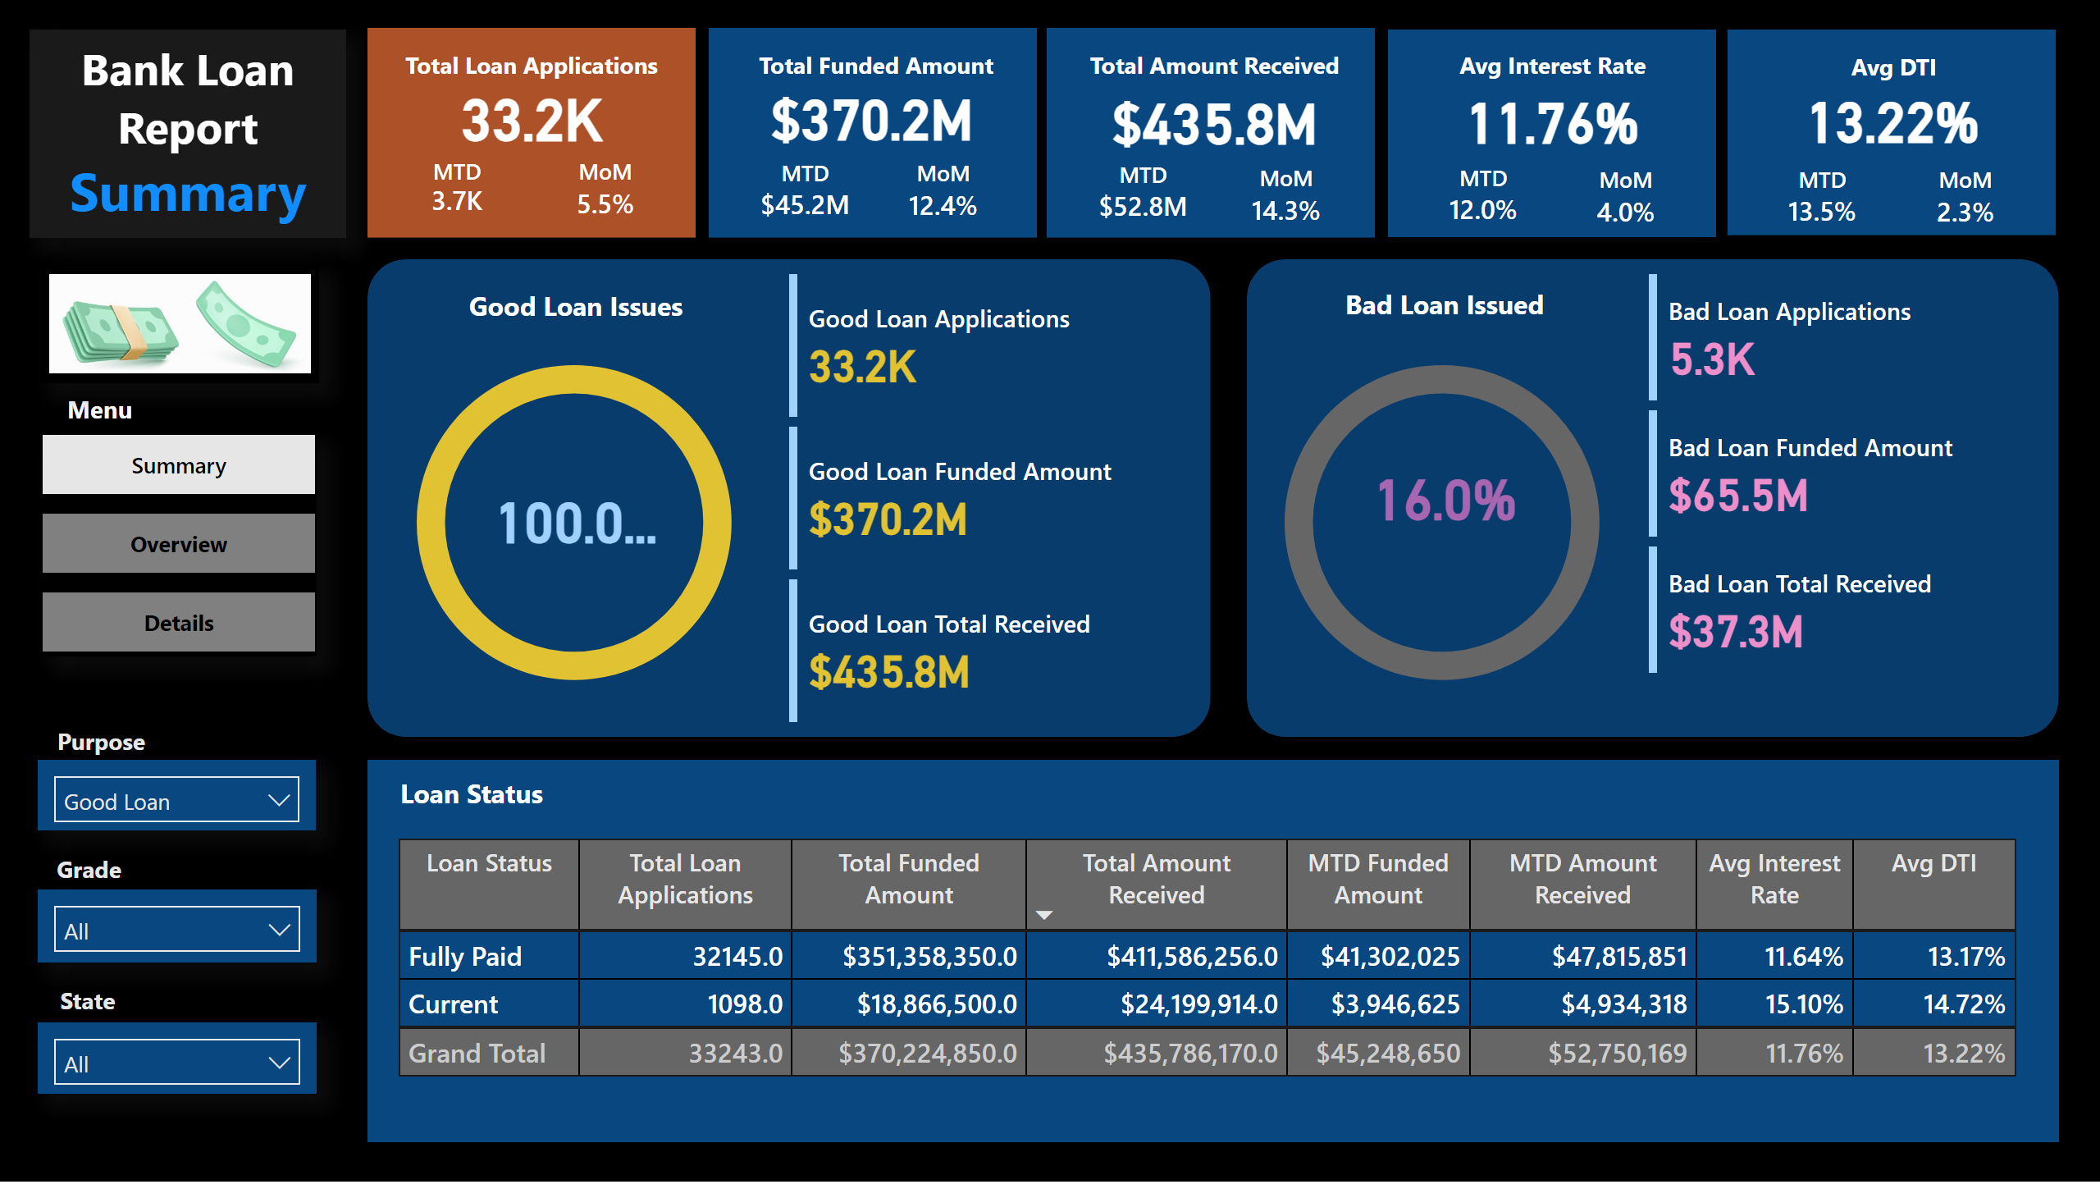

Slide 3
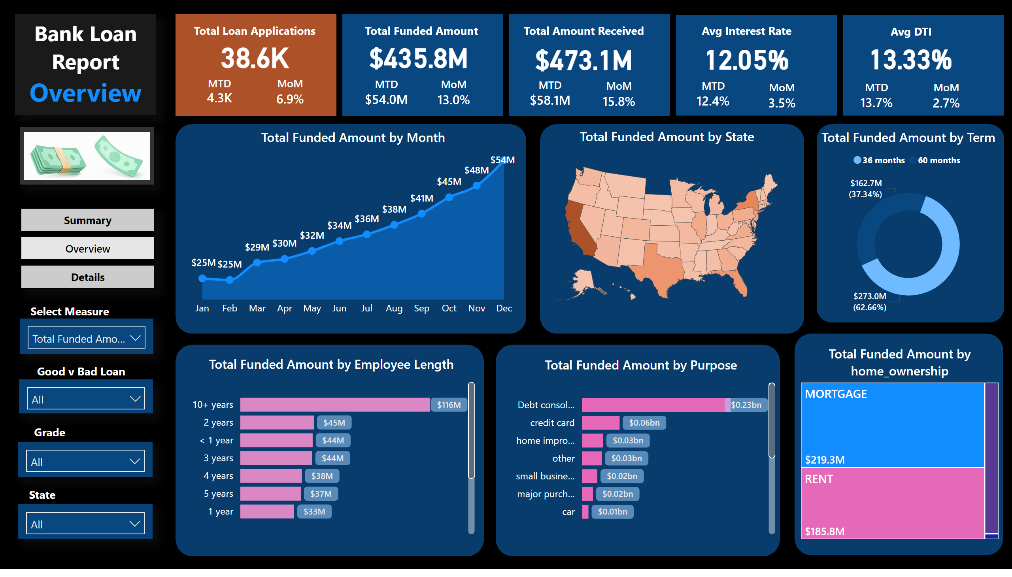

Slide 4
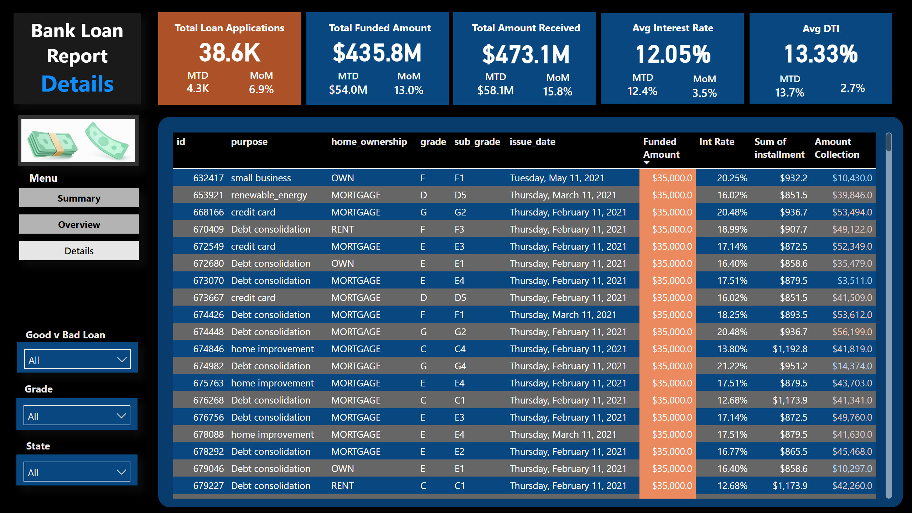

Slide 5
Bank Loan Analysis Dashboard: An End-to-End Project with SQL Server and Power BI
This project outlines the development of a comprehensive bank loan analysis dashboard suite using SQL Server for data storage and analysis, followed by data visualization in Power BI.
Project Overview
Financial institutions require a robust system to analyze their loan portfolio performance, identify trends, and make informed decisions. This project delivers a data-driven solution by leveraging the combined strengths of SQL Server and Power BI.

Slide 6
Workflow:
Data Storage and Management: Utilize SQL Server to store the bank loan data securely and efficiently.
Data Analysis and Transformation: Employ SQL queries within SQL Server to analyze the loan data to find insights and for verification with the results of powerBI.
Data Visualization and Exploration: Import the data into Power BI and transform the data according to requirements to create interactive dashboards that visually represent key insights and trends
Tools and Technologies
Microsoft SQL Server: This relational database management system acts as the central storage and analysis platform for the bank loan data.
SSMS (SQL Server Management Studio): This acts as an integrated environment for managing any SQL infrastructure.
Microsoft Power BI: This business intelligence tool serves as the primary platform for building and deploying the interactive dashboards for data visualization and exploration

Slide 7
Key Features
Consolidated Data Storage: Maintain a centralized and secure data repository for all bank loan information within SQL Server.
Data Cleaning and Transformation: Cleanse the raw loan data in SQL Server to address inconsistencies and prepare it for effective visualization in Power BI.
KPIs at a Glance: Gain immediate insights into loan portfolio health through key performance indicators (KPIs) displayed in the Power BI dashboards.
Trend Analysis: Analyze trends over time by visualizing loan applications, approvals, repayments, and other loan characteristics within Power BI.
Granular Loan Details: Explore individual loan information in Power BI through interactive dashboards, allowing for focused analysis of specific loan attributes.
Interactive Filtering: Leverage filters and slicers within Power BI dashboards to refine your analysis by loan term, purpose, employee tenure, application date, or other relevant data points

Slide 8
Data Requirements
The project requires a dataset containing comprehensive bank loan information. Below is the description ofthe attributes -
ID: Unique identifier for each loan application.
Address_state: State in which the borrower resides.
Application_type: Type of loan application (e.g., individual, joint).
Emp_length: Length of employment of the borrower.
Emp_title: Title or occupation of the borrower.
Grade: Grade assigned to the borrower based on credit risk.
Home_ownership: Type of home ownership (e.g., own, mortgage, rent).
Issue_date: Date on which the loan was issued.
Last_credit_pull_date: Date when the creditor last pulled the borrower's credit report.
Last_payment_date: Date of the borrower's last payment.
Loan_status: Status of the loan (e.g., current, fully paid, charged off).
Next_payment_date: Date of the borrower's next scheduled payment.
Loan_status: Status of the loan (e.g., current, fully paid, charged off).
Next_payment_date: Date of the borrower's next scheduled payment.
Member_id: Unique identifier for each member.
Purpose: Purpose of the loan (e.g., debt consolidation, home improvement).
Sub_grade: Sub-grade assigned to the borrower based on credit risk.
Term: Duration of the loan (e.g., 36 months, 60 months).
Verification_status: Indicates if income was verified by the lender.
Annual_income: Annual income of the borrower.
DTI (Debt-to-Income ratio): Ratio of the borrower's total monthly debt payments to their gross monthly income.
Installment: Monthly payment amount.
Int_rate: Interest rate on the loan.
Loan_amount: Total amount of the loan.
Total_acc: Total number of credit accounts.
Total_payment: Total amount paid by the borrower.

Slide 9
Phase 1: Data Storage and Analysis in SQL Server
Bank Loan Data Processing Overview
Data Loading: The specific method for loading data depends on your environment. However, the provided queries assume the data already resides in a table named bank_loan_data.
Key Performance Indicators (KPIs): The provided queries calculate various KPIs that can be used to understand the overall health of the loan portfolio.
Detailed Loan Analysis: The provided queries demonstrate how to analyze loan data by various dimensions:
Loan Status
Month
State
Loan Term
Employee Length
Loan Purpose
Home Ownership
4. Filtering for Dashboards: The last query showcases how to filter data based on specific criteria (e.g., grade = 'A'). This demonstrates the power of SQL Server in preparing data for visualizations in Power BI dashboards, where users can interact with filters and explore the data in more detail.

Slide 10
Phase 2: Data Visualization and Exploration in Power BI
Connect to SQL Server: Establish a secure connection between Power BI and the SQL Server database containing the prepared loan data.
Data Import and Modeling: Import the data from SQL Server into Power BI. Clean and Transform the data for further shaping and modeling.
Dashboard Design and Development: Create interactive dashboards in Power BI that effectively visualize KPIs, trends, and loan details using measures and new tables using DAX queries.
Testing and Refinement: Test the dashboards for functionality, usability, and visual appeal. Refine and iterate on the design based on user feedback.
Importance of Date Table
A dedicated date table created within SQL Server is crucial for time-based analysis in Power BI as mentioned in step 2 of phase 2.

